Slide 1


GRADE 8 ICT/DESIGN
Lesson 3: Drawing in Game Lab (Code.org 3b)
Ms. Abboud • Grade 8 - ICT/Design • Term 1, Week 9

Slide 2
Learning Objectives
WALT - We Are Learning To
WILF - What I'm Looking For
Use ordered code commands to draw shapes in Game Lab.
My shapes appear in the right place and order.
I found and fixed at least one bug.

Slide 3
Academic Vocabulary
Sequence
Program
The order in which commands run; later shapes are drawn on top of earlier ones.
An algorithm that has been coded into something that can be run by a machine.
Bug
Debugging
Part of a program that does not work correctly.
Finding and fixing problems in an algorithm or program.

Slide 4
Frayer Model: Sequence
DEFINITION
CHARACTERISTICS
The order in which commands run; later shapes are drawn on top of earlier ones.
Order matters; the computer runs commands from top to bottom.
SEQUENCE
EXAMPLES
NON-EXAMPLES
Drawing the face ellipse first, then the eyes on top of it.
Drawing the eyes first, so the face covers them.

Slide 5
National Identity Integration
UAE National Programme for Coders: the UAE is building a large community of programmers to shape its digital future. Today you write your first drawing code in Game Lab.

Slide 6
STARTER
Tell a Computer to Draw a Face
How could you tell a computer to draw a face?
What order would you draw the parts in, and why?
Hook • Engage & Ask
5 - 10 minutes

Slide 7
LESSON CORE
I Do: Meet Game Lab
Watch the Drawing in Game Lab video and tour the workspace.
rect() draws a rectangle, ellipse() an oval, fill() sets the color.
Gradual Release of Responsibility
35 - 45 minutes
Example: shapes drawn in order
fill("yellow");
ellipse(200, 200, 150, 150);
fill("black");
rect(160, 170, 20, 20);
1 / 3

Slide 8
LESSON CORE
We Do: Predict, Then Run
Read a short program and predict the drawing.
Run it: were you right? What would change if we swapped two lines?
Gradual Release of Responsibility
35 - 45 minutes
2 / 3

Slide 9
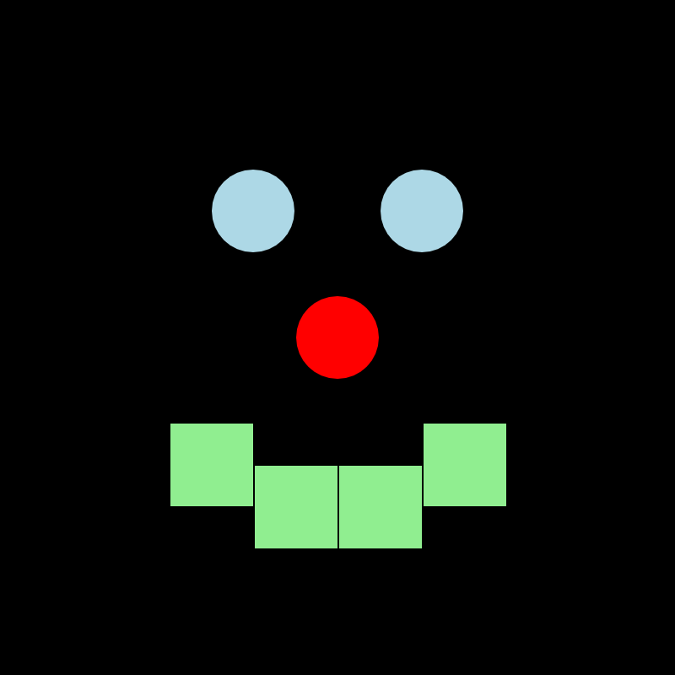
LESSON CORE
You Do: Code a Picture
Complete the Game Lab levels.
Code a picture with at least three shapes and fill() colors; fix any bugs.
Code.org Game Lab example: a face drawn with shapes
Gradual Release of Responsibility
35 - 45 minutes
3 / 3

Slide 10
CLOSURE
Show Your Picture
Screenshot your picture with at least three shapes.
Tell a partner about one bug you fixed.
Transition & Extend
5 - 10 minutes

